Slide 1
Fundamentals of
C

Slide 2
What is C?
C is a general-purpose programming language created by Dennis Ritchie at Bell Laboratories in 1972.
Despite its age, C remains highly popular due to its fundamental role in computer science.
Strongly associated with UNIX, as it was developed to write the UNIX operating system.

Slide 3
Why Learn C?
One of the most popular programming languages in the world.
Knowledge of C facilitates learning other languages like Java, Python, C++, and C# due to similar syntax.
C is very fast compared to other languages such as Java and Python.
Versatile: used in both applications and technologies.

Slide 4
Statements in C
A computer program is a list of instructions executed by a computer.
In C, these instructions are called statements.
Example:
printf("Hello World!");
!Important: Every C statement ends with a semicolon `;`.

Slide 5
Many Statements Example
Example:
printf("Hello World!");
printf("Have a good day!");
return 0;
Explanation:
- First statement prints "Hello World!".
- Second statement prints "Have a good day!".
- Third statement ends the program successfully.

Slide 6
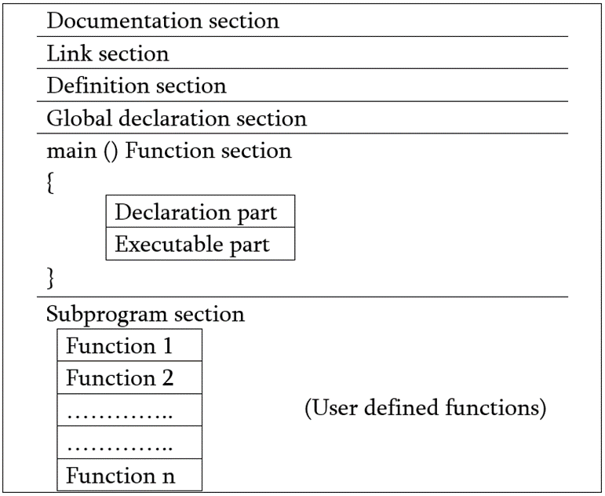
Structure of C
Documentation Section
Provides an overview of the program: Includes title, author, and summary information.
Uses comment lines: Helps in understanding the program's purpose and functionality.
Link Section / Header File Declaration Section
It Links Compiler to Link Functions from System Library

Slide 7
Definition Section
Defines Symbolic Constants
Eg. #define Count 10
Global Declaration Section
Variables that are accessed by one or more functions are called Global Variable
Global Variables are declared in this Section
Main function Section
Used to start of actual C program
It includes two parts as declaration part and executable part
Subprogram Section
It has all User-defined Functions that are called in main
User Defined Functions are generally placed immediately after main

Slide 8
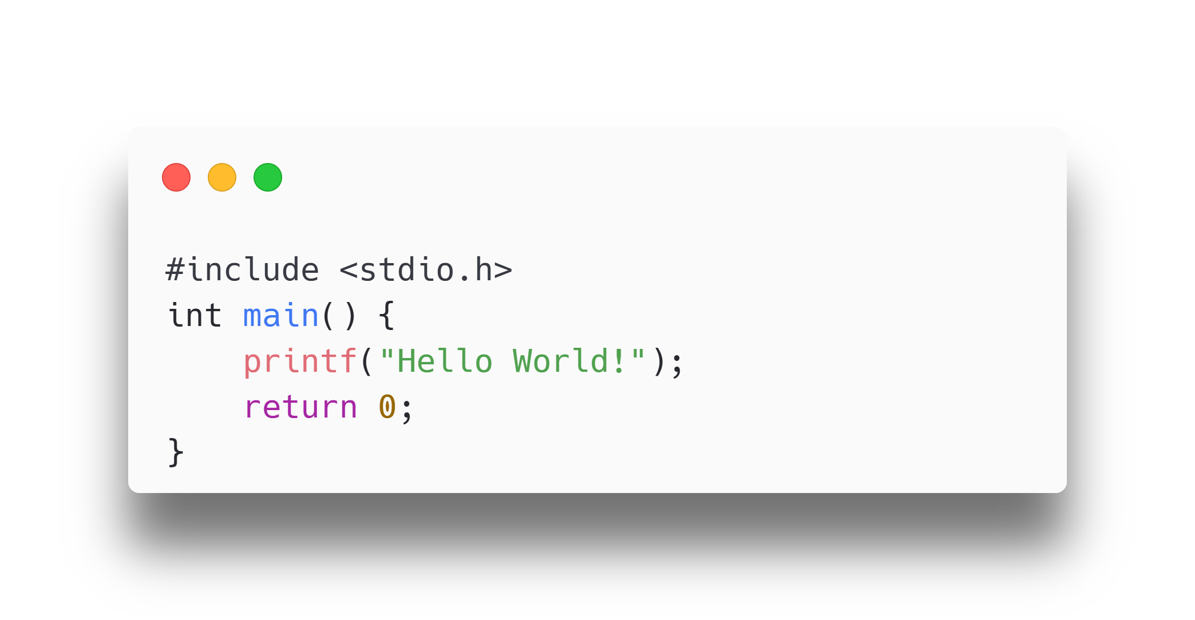
Basic C Code Example
Code:
Explanation:
- `#include <stdio.h>`: Header file library for input/output functions.
- `int main() {}`: Main function where the code execution begins.
- `printf("Hello World!");`: Prints "Hello World!" to the screen.
- `return 0;`: Ends the main function.

Slide 9
Comments in C
A comment in C is a piece of text within the code that is ignored by the compiler, used to explain code and improve readability.
Types of Comments
Single-line Comments
Multi-line Comments

Slide 10
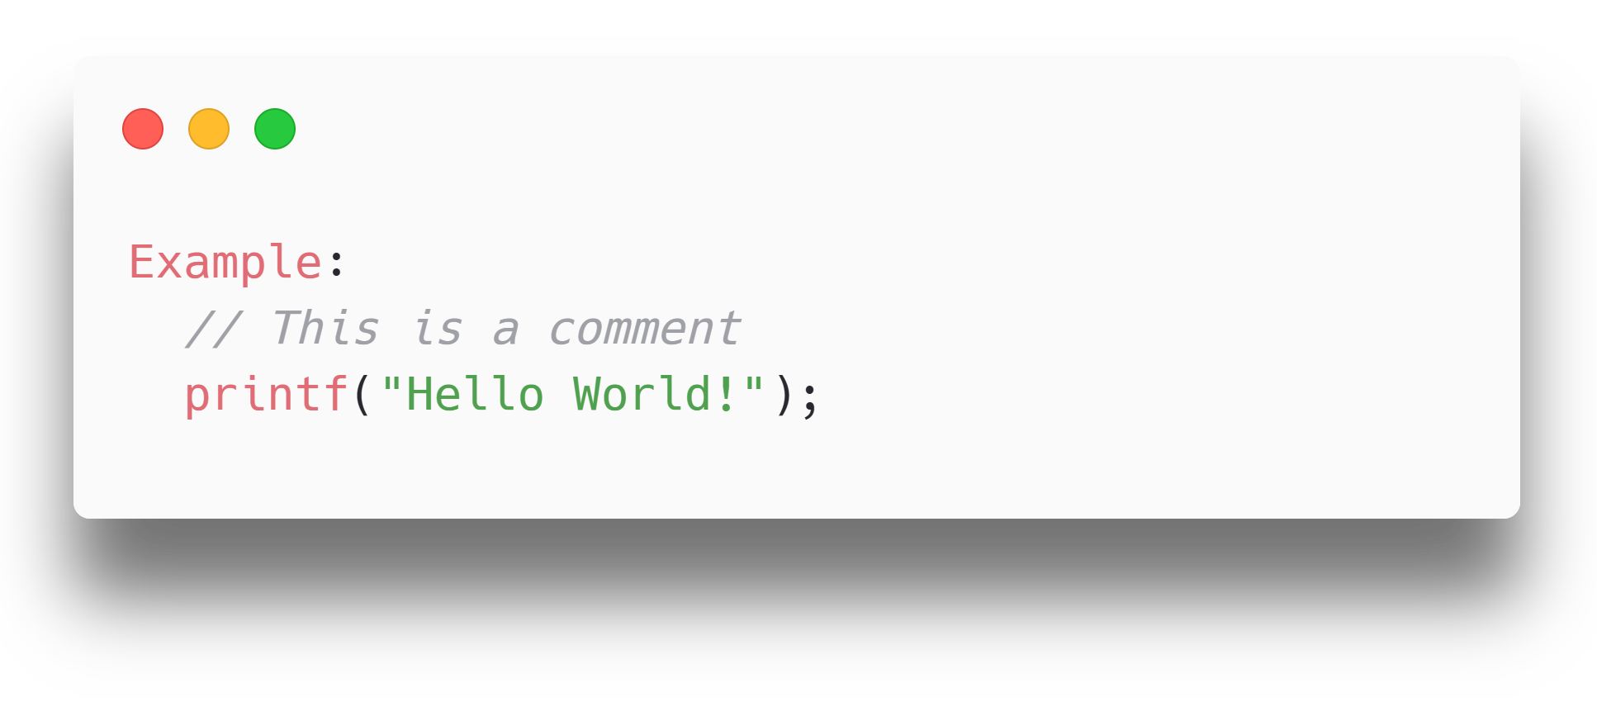
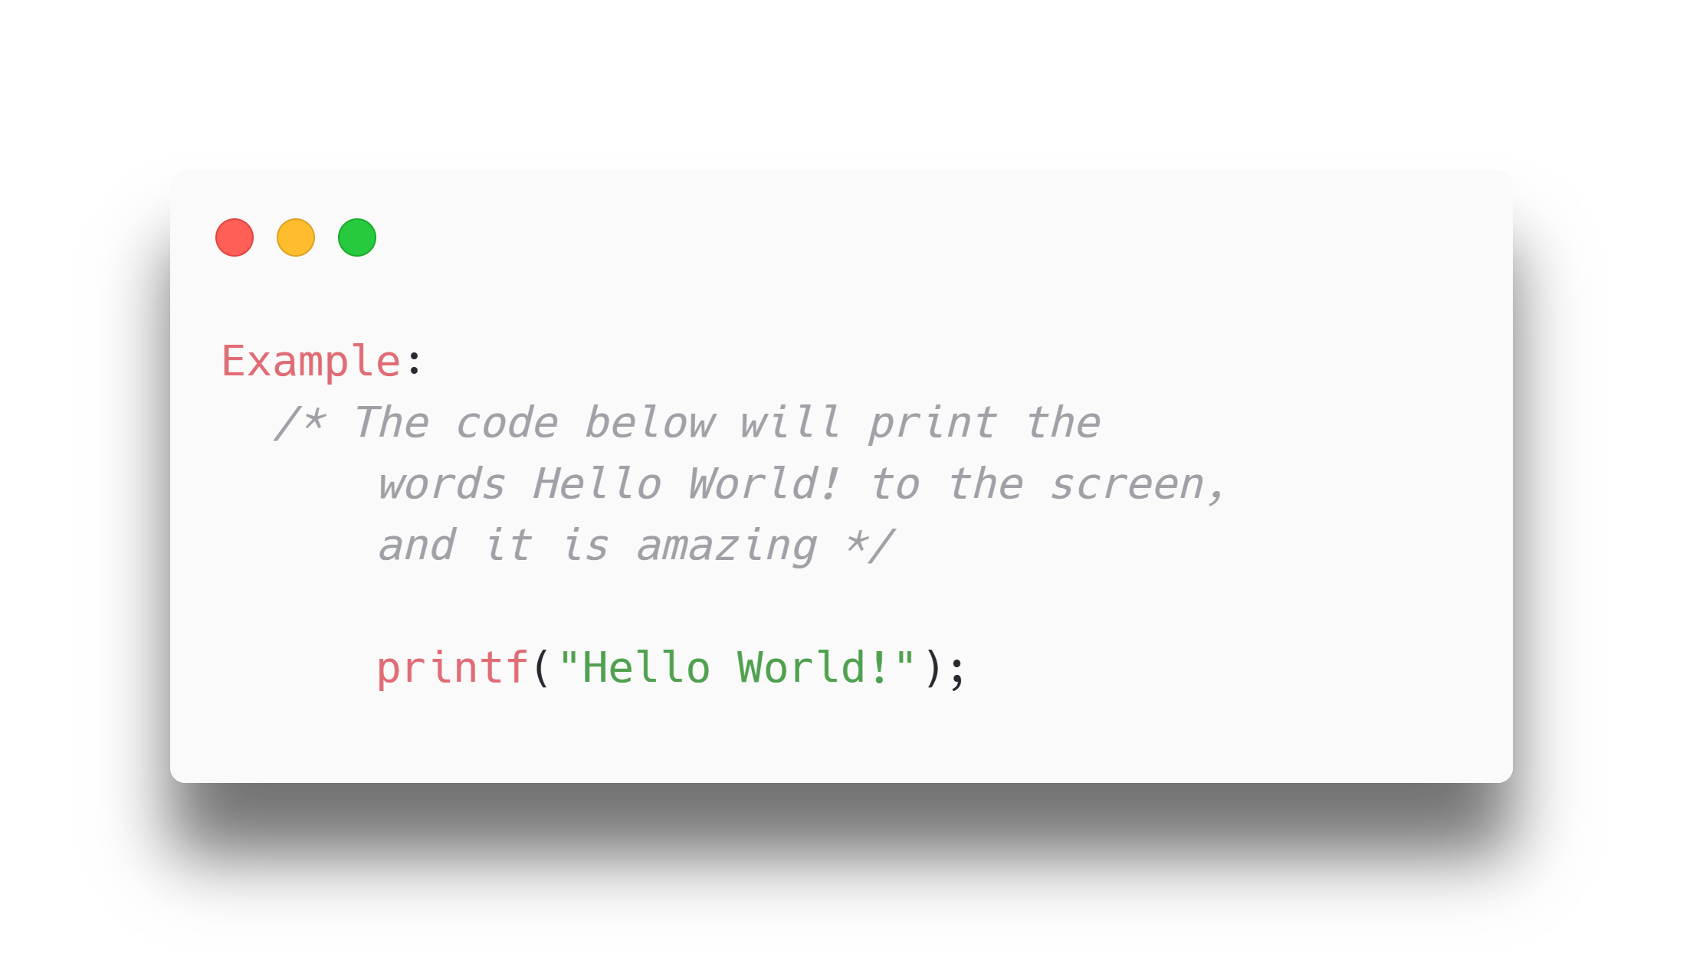
Types of Comments
2. Multi-line Comments
Start with /* and end with */
Text between /* and */ is ignored by the compiler
1. Single-line Comments
Start with two forward slashes (//)

Slide 11
Header files
C Header files offer the features like library functions, data types, macros, etc. by importing them into the program with the help of a preprocessor directive “#include”.
Header files contain predefined standard library functions.
The .h extension is used for header files.
Included in the program using the #include directive.
Including Header Files
Syntax:
#include <filename.h> // for files in system/default directory
#include "filename.h" // for files in the same directory as source file

Slide 12
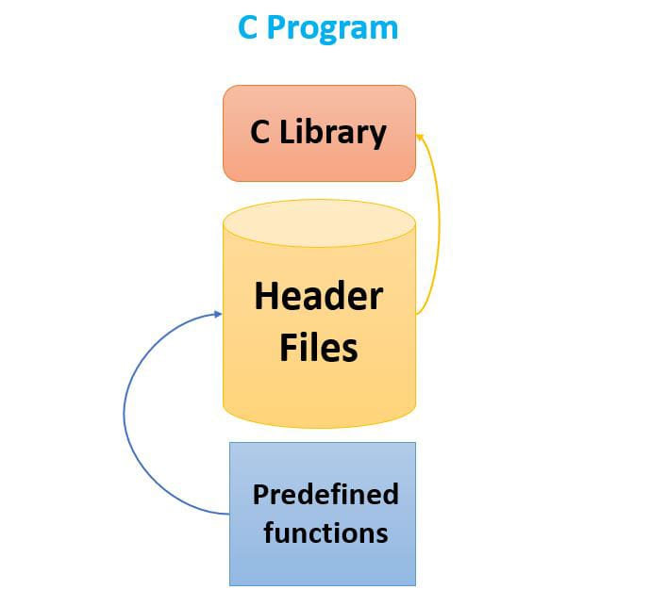
Header files
Standard Header Files
Header File | Description | Functions/Macros/ Variables
stdio.h | Input/Output functions | scanf(), printf(), fopen(), FILE
stdlib.h | General utility functions | atoi(), atof(), malloc()
math.h | Mathematics functions | sin(), cos(), pow(), sqrt()
string.h | String functions | strcpy(), strlen(), strcat()

Slide 13
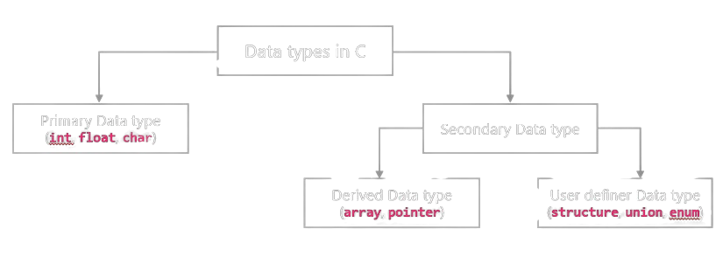
Data types

Slide 14
Primary Data Types
Primary data types are built in data types which are directly supported by machine.
They are also known as fundamental data types.
int:
- int, datatype can store integer number which is whole number without fraction part such as 10, 105 etc.
- C language has 3 classes of integer storage namely short int, int and long int. All of these data types have signed and unsigned forms.
- Example: int a=10;

Slide 15
Primary Data Types
float:
• float data type can store floating point number which represents a real number with decimal point and fractional part such as 10.50, 155.25 etc.
• When the accuracy of the floating point number is insufficient, we can use the double to define the number. The double is same as float but with longer precision.
• To extend the precision further we can use long double which consumes 80 bits of memory space.
• Example: float a=10.50;

Slide 16
Primary Data Types
char:
• Char data type can store single character of alphabet or digit or special symbol such as 'a', '5' etc.
• Each character is assigned some integer value which is known as ASCII values.
• Example: char a='a';
void:
• The void type has no value therefore we cannot declare it as variable as we did in case of int or float or char.
• The void data type is used to indicate that function is not returning anything.

Slide 17
Secondary Data types
Secondary data types are not directly supported by the machine.
It is combination of primary data types to handle real life data in more convenient way.
It can be further divided in two categories,
Derived data types: Derived data type is extension of primary data type. It is built-in system and its structure cannot be changed. Examples: Array and Pointer.
• Array: An array is a fixed-size sequenced collection of elements of the same data type.
• Pointer: Pointer is a special variable which contains memory address of another variable.

Slide 18
Secondary Data types
User defined data types: User defined data type can be created by programmer using combination of primary data type and/or derived data type. Examples: Structure, Union, Enum.
• Structure: Structure is a collection of logically related data items of different data types grouped together under a single name.
• Union: Union is like a structure, except that each element shares the common memory.
• Enum: Enum is used to assign names to integral constants, the names make a program easy to read and maintain.

Slide 19
Data types
Example:
// Create variables
int a = 5; // Integer (whole number)
float b = 5.99; // Floating point num
char c = 'D'; // Character
// Print variables
printf("%d\n", a);
printf("%f\n", b);
printf("%c\n", c);
Format Specifier | Data Type | Example Output
%d or %i | int | 5
%f or %F | float | 5.99
%lf | double | 5.990000
%c | char | D
%s | string | "Hello"

Slide 20
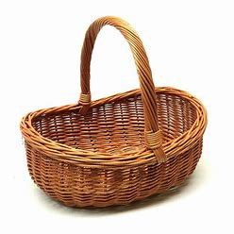
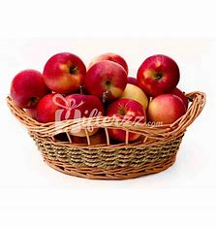
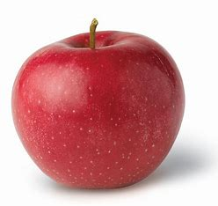

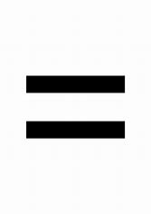
Variables in C
Syntax:
type variableName = value;
type is one of C types (such as int)
variableName is the name of the variable (such as x or myName)
The equal sign is used to assign a value to the
variable.
Example:
int myNum = 15;
Variables are containers for storing data values, like numbers and characters.
Data
Variable
Variable with data

Slide 21
Rules for naming variables
1. Contain letters, digits, and underscores.
2. Begin with a letter or an underscore.
3. Case-sensitive (myVar and myvar are different).
4. No whitespaces and special characters (e.g., !, #, %) except underscore( _ ) & dollar( $ ).

Slide 22
Rules for naming variables
5. Cannot use reserved words (e.g., int).
6. Camel Case:
The first word starts with either a lowercase or uppercase letter, and the following words start with an uppercase letter.
Examples: myVariableName, MyVariableName, iPhone, eBay.
7. Pascal Case (Upper Camel Case):
The first letter of each word, including the initial word, is capitalized.
Examples: MyVariableName, YouTube, PowerPoint.

Slide 23
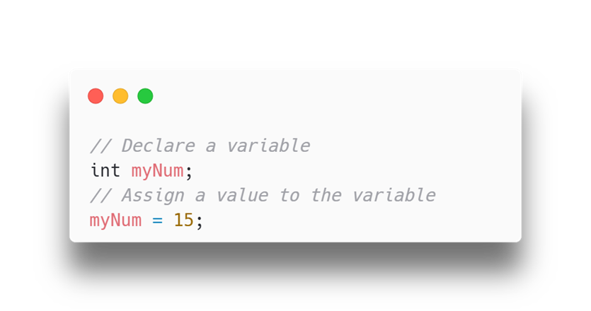
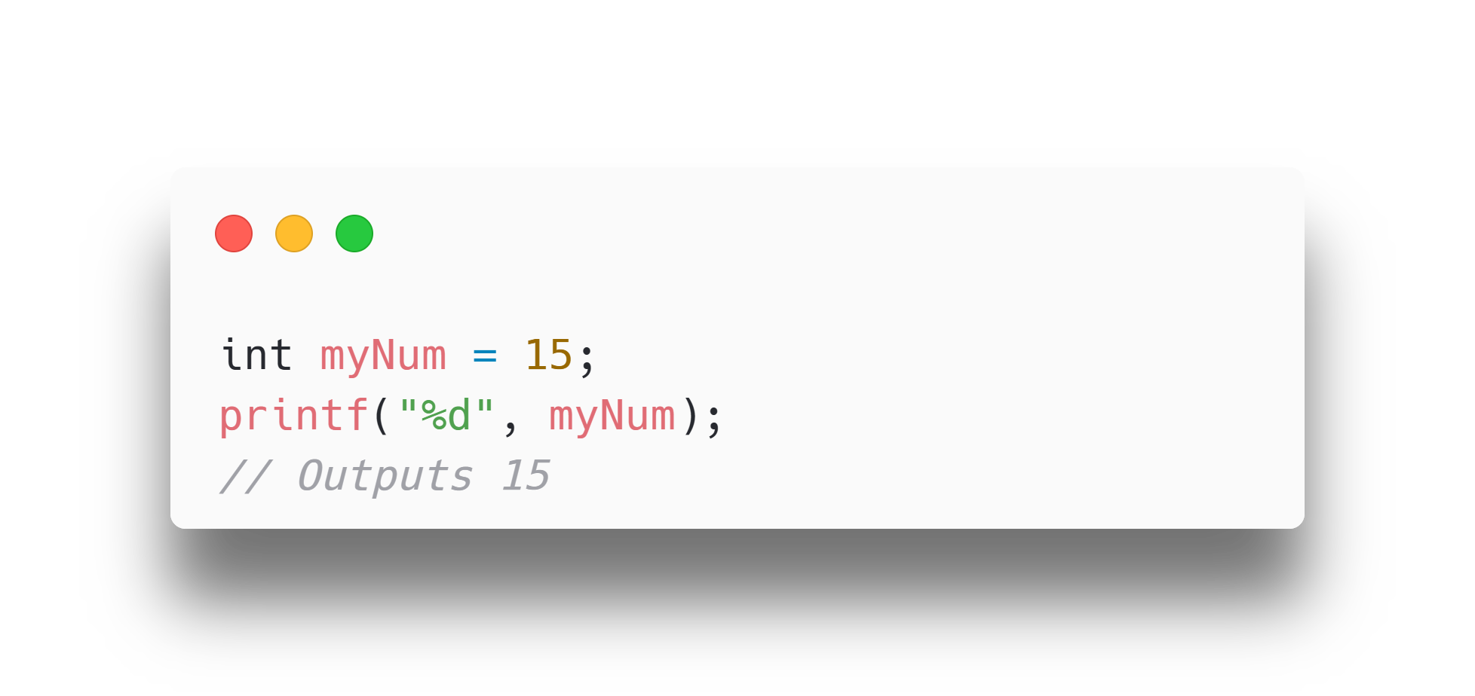
Variables in C
If you assign a new value to an existing variable, it will overwrite the previous value:
int myNum = 15; // myNum is 15 myNum = 10; // Now myNum is 10
You can also assign the value of one variable to another:
int myNum = 15; int myOtherNum = 23; // Assign the value of myOtherNum (23) to myNum myNum = myOtherNum; // myNum is now 23, instead of 15 printf("%d", myNum);
To declare more than one variable of the same type, use a comma-separated list:
int x = 5, y = 6, z = 50; printf("%d", x + y + z);
You can also declare a variable without assigning the value, and assign the value later:
Format specifiers are used together with the printf() function to tell the compiler what type of data the variable is storing. It is basically a placeholder for the variable value.

Slide 24
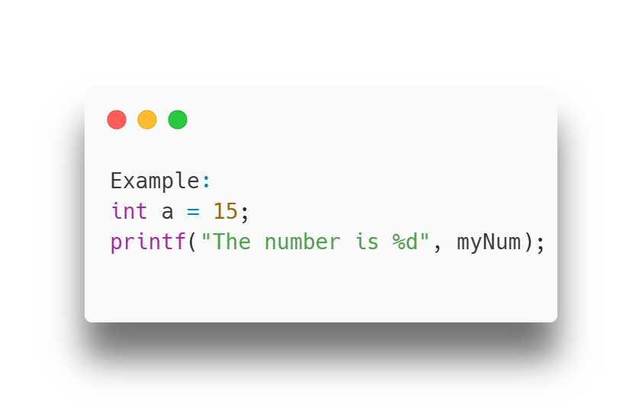
Outputting Variables
Use `printf()` to output values or print text.

Slide 25
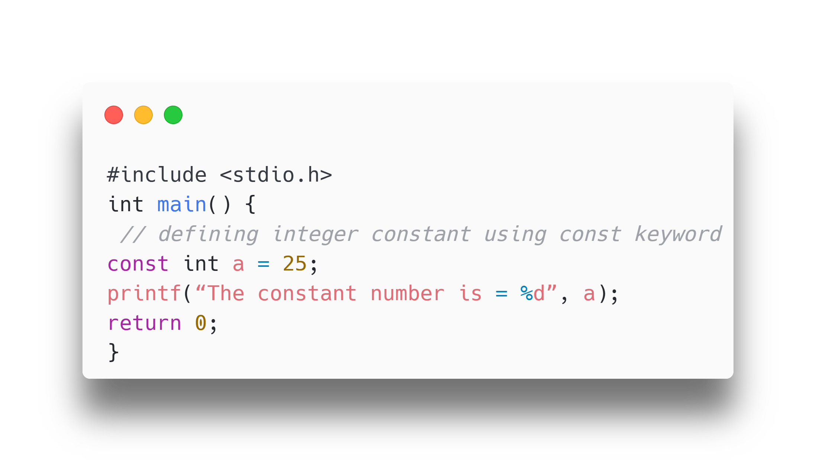
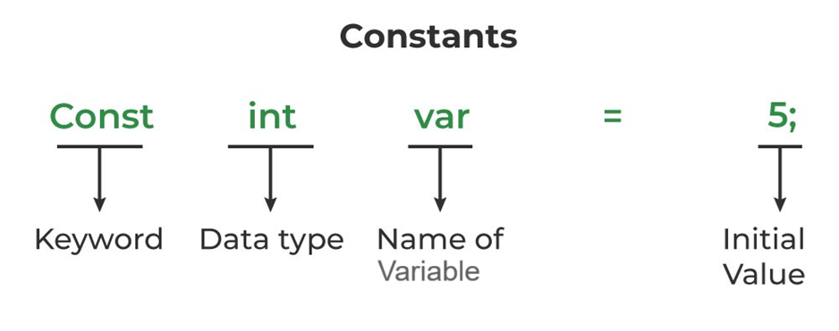
Constants in C
A constant in C is a variable that cannot be modified once it is declared in the program. We cannot make any change in the value of the constant variables after they are defined.
Syntax:
const data_type var_name = value;

Slide 26
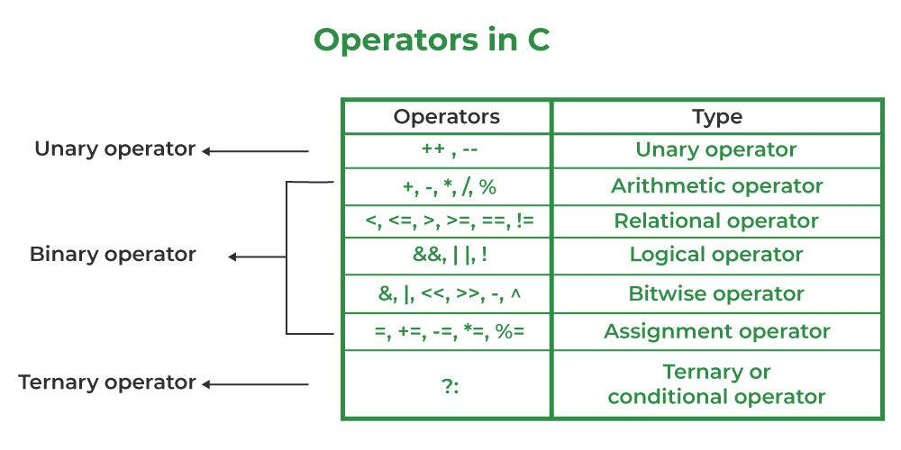
Operators
Operators are used to perform operations on variables and values.
Types of Operators
Arithmetic operators
Relational operators
Logical operators
Bitwise operators
Assignment operators

Slide 27
Arithmetic Operators
Operator | Name | Description | Example
+ | Addition | Adds together two values | x + y
- | Subtraction | Subtracts one value from another | x - y
* | Multiplication | Multiplies two values | x * y
/ | Division | Divides one value by another | x / y
% | Modulus | Returns the division remainder | x % y
Perform common mathematical operations.
Example:
int sum1 = 100 + 50; // 150 (100 + 50)
int sum2 = sum1 + 250; // 400 (150 + 250)
int sum3 = sum2 + sum2; // 800 (400 + 400)

Slide 28
Unary Operators
Operator | Name | Description | Example
++ | Increment | Increases the value of a variable by 1 | ++x
-- | Decrement | Decreases the value of a variable by 1 | --x
Perform Increment Or Decrement Operations
Example:
int sum1 = 100;
printf(sum1++);
Printf(++sum1);

Slide 29
Relational Operators
Operator | Name | Description | Example
== | Equal to | Returns 1 if the values are equal | x == y
!= | Not equal | Returns 1 if the values are not equal | x != y
> | Greater than | Returns 1 if the first value is greater | x > y
< | Less than | Returns 1 if the first value is lesser | x < y
>= | Greater than or equal to | Returns 1 if the first value is greater or equal | x >= y
<= | Less than or equal to | Returns 1 if the first value is lesser or equal | x <= y
Compare two values (or variables).
Example:
int x = 5;
int y = 3;
printf("%d", x > y);
// returns 1 (true) because 5 is greater than 3

Slide 30
Logical Operators
Operator | Name | Description | Example
&& | AND | Returns 1 if both statements are true | x < 5 && x < 10
|| | OR | Returns 1 if at least one of the statements is true | x < 5 || x < 10
! | NOT | Reverses the result, returns 0 if the result is 1 | !(x < 5 && x < 10)
Determine the logic between variables or values by combining multiple conditions.
Example:
if (x > 5 && x < 10)
printf("x is between 5 and
10\n");
if (x < 5 || x > 10)
printf("x is outside the range 5 to 10\n");

Slide 31
Bitwise Operator
Operator | Name | Description | Example
& | Bitwise AND | Performs a bitwise AND operation between two operands. | x & y
| | Bitwise OR | Performs a bitwise OR operation between two operands. | x|y
^ | Bitwise XOR | Performs a bitwise XOR operation between two operands. | x ^ y
~ | Bitwise NOT | Performs a bitwise NOT operation (inverts all bits) on the operand. | ~x
<< | Left Shift | Shifts the bits of the left operand to the left by the number of positions specified by the right operand. | x << 2
>> | Right Shift | Shifts the bits of the left operand to the right by the number of positions specified by the right operand. | x >> 2
Bitwise operators perform operations on the binary representations of integers.
Example:
int a = 4, b = 5;
printf("a & b :%d\n", a & b); printf("a | b :%d\n", a | b);
printf("a ^ b :%d\n", a ^ b);

Slide 32
Assignment Operators
Operator | Name | Description | Example
= | Assignment | Assigns the value on the right to the variable on the left | x = 5
+= | Addition Assignment | Adds the right operand to the left operand and assigns the result to the left operand | x += 3
-= | Subtraction Assignment | Subtracts the right operand from the left operand and assigns the result to the left operand | x -= 3
*= | Multiplication Assignment | Multiplies the right operand with the left operand and assigns the result to the left operand | x *= 3
/= | Division Assignment | Divides the left operand by the right operand and assigns the result to the left operand | x /= 3
%= | Modulus Assignment | Takes modulus using two operands and assigns the result to the left operand | x %= 3
Assign values to variables.
Example:
int x = 10;
x += 5; // x is now 15

Slide 33
Ternary Operator
We will See it in Control Structure….

Slide 34
Type conversion
Type conversion is the process of converting the value of one data type to another.
There are two types of type conversion in C:
1. Implicit Conversion (Automatic)
2. Explicit Conversion (Manual)

Slide 35
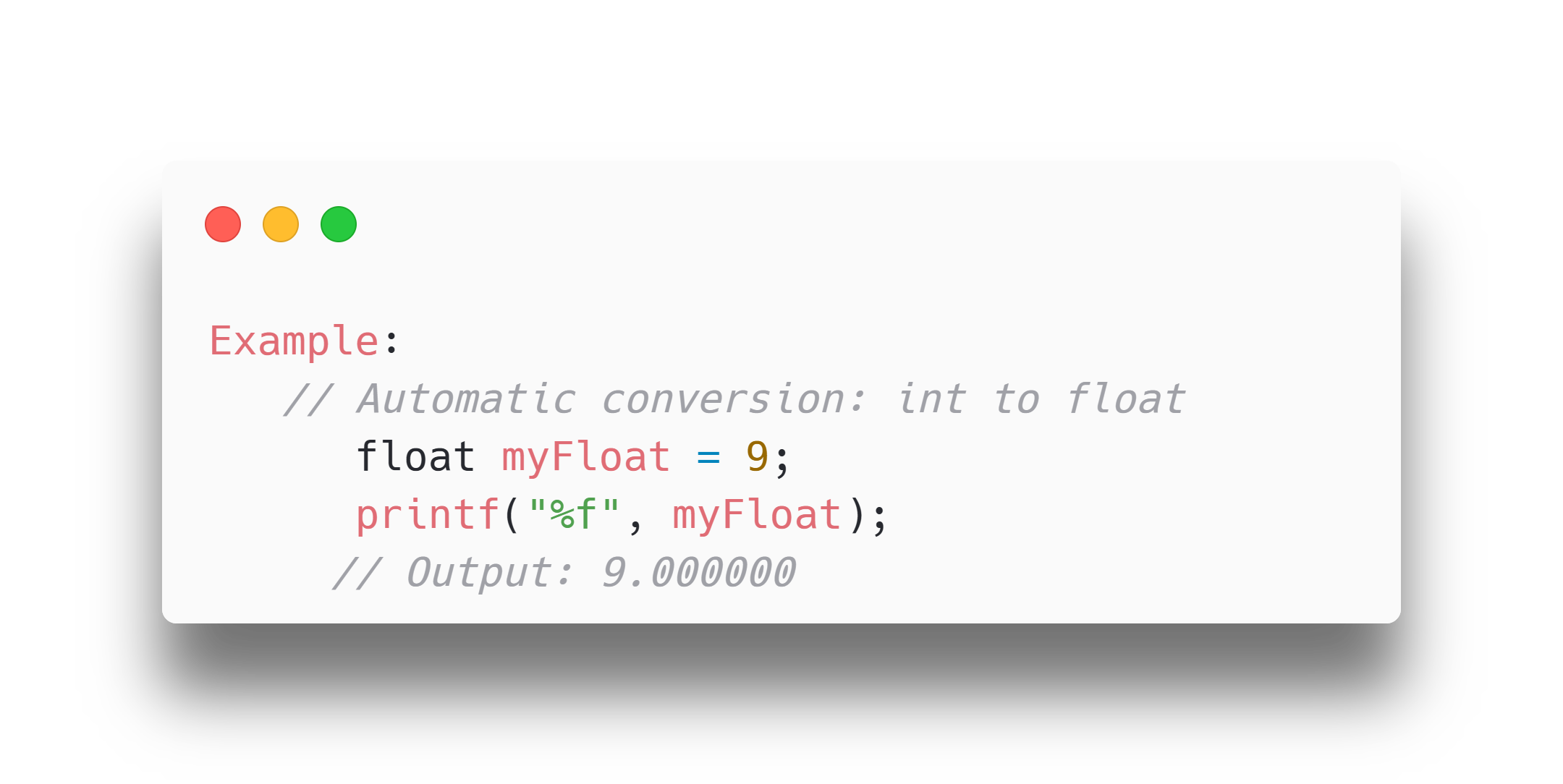
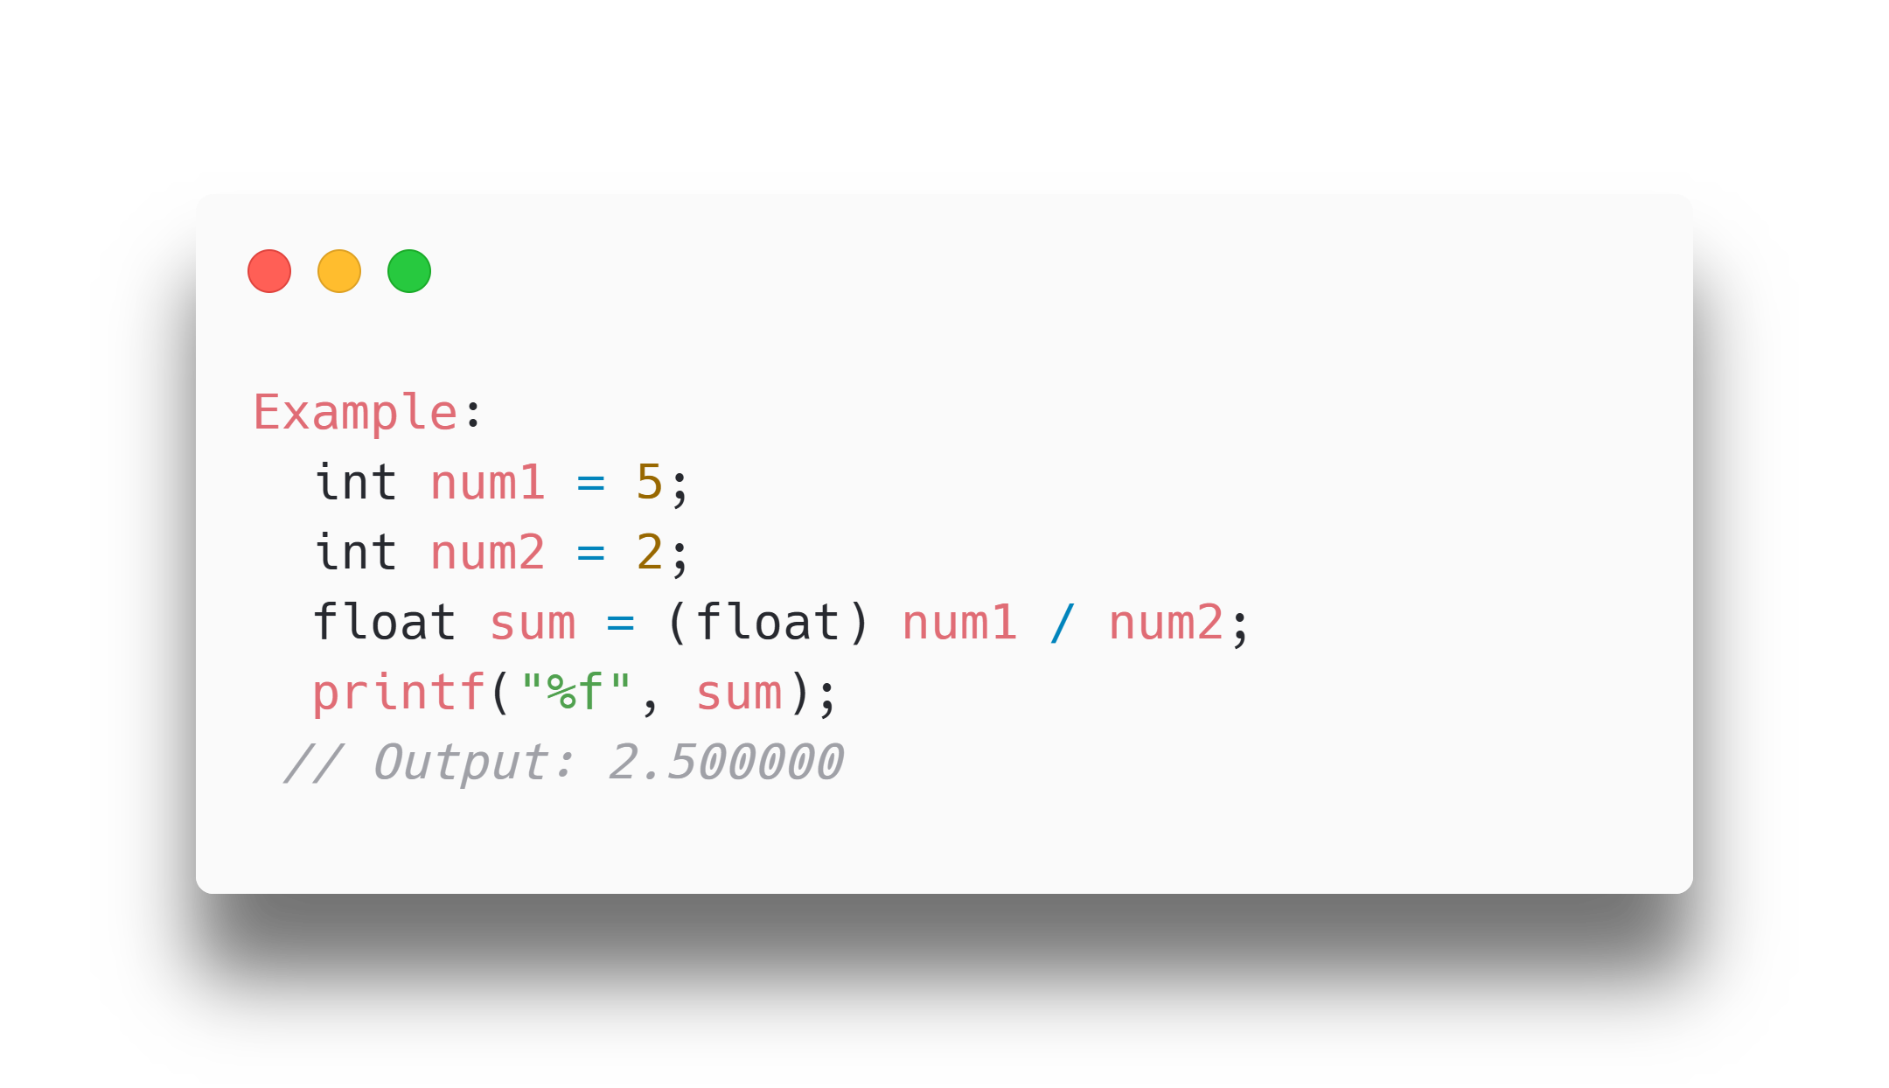
Types of Type Conversion
Implicit Conversion
Implicit conversion is automatically performed by the compiler when you assign a value of one type to another.
Explicit Conversion
Explicit conversion is done manually by the programmer using casting.
Syntax: Place the type in parentheses before the value.

Slide 36
I/O functions
List of I/O Functions
printf() | Outputs formatted text to the console.
scanf() | Reads formatted input from the console.
fgets() | Reads a line of text from a file or input stream.
fputs() | Writes a string to a file or output stream.
getchar() | Reads a single character from the standard input.
putchar() | Writes a single character to the standard output.
Input/Output (I/O) functions in C are used to perform input and output operations.
They are part of the C Standard Library and are declared in the <stdio.h> header file.

Slide 37
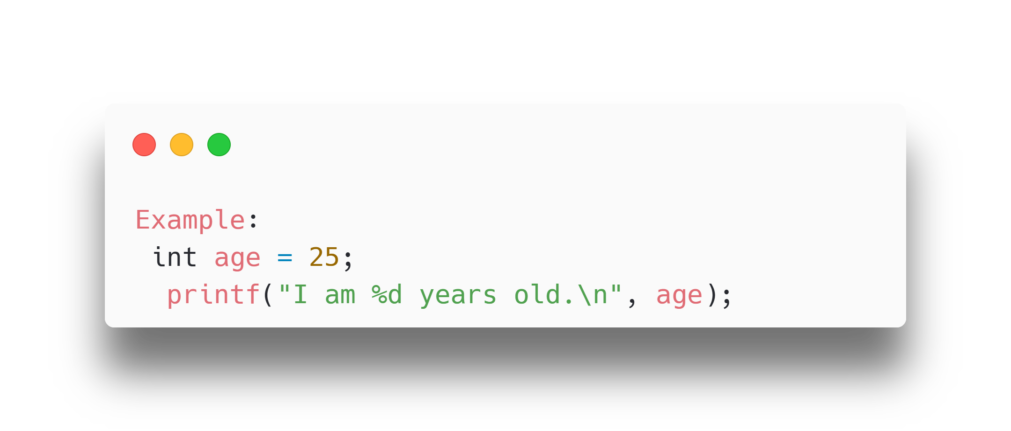
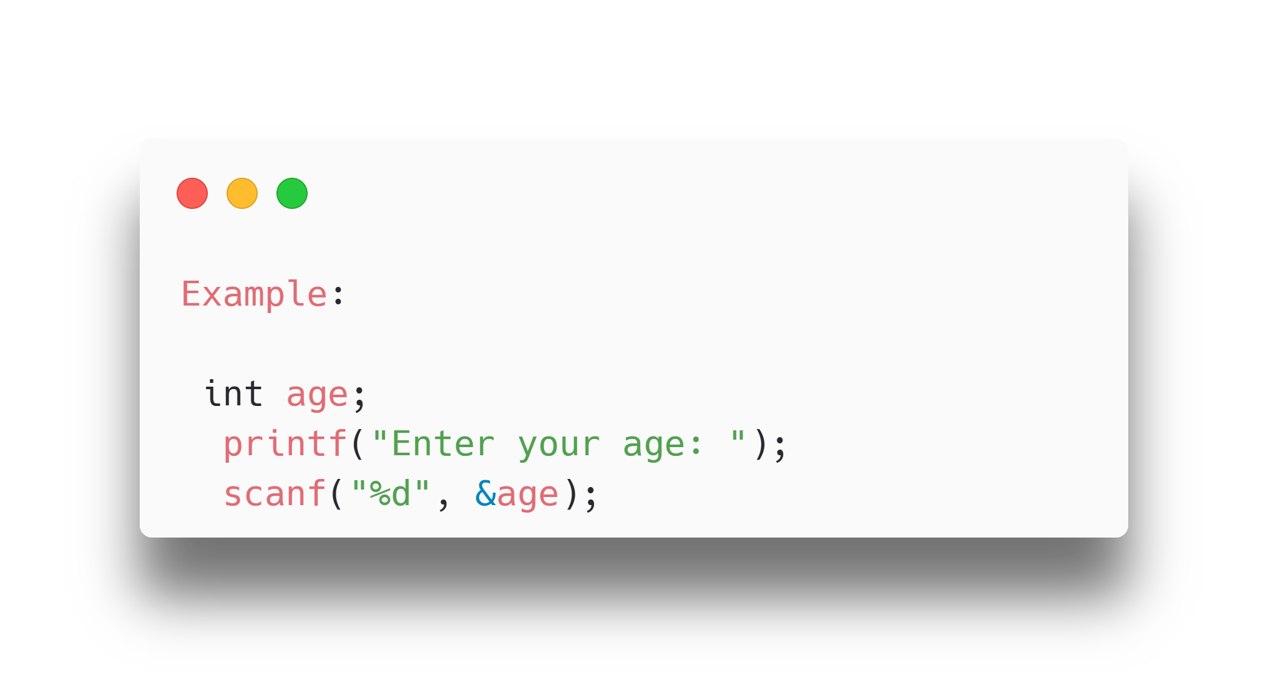
I/O Functions Example
printf()
Used for outputting formatted text to the console.
Syntax:
printf("format string", arguments);
scanf()
Used for reading formatted input from the console.
Syntax:
scanf("format string", &variables);

Slide 38
Control Structure in
C

Slide 39
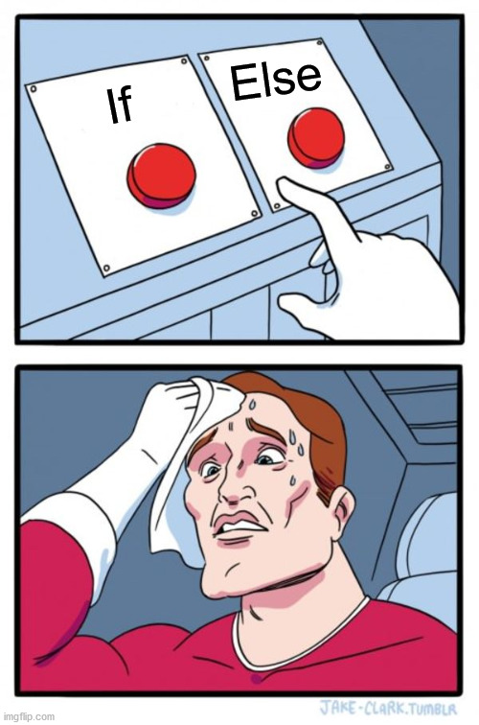
Decision Making
C program statements are executed sequentially.
Decision Making statements are used to control the flow of program.
It allows us to control whether a program segment is executed or not.
It evaluates condition or logical expression first and based on its result (either true or false), the control is transferred to particular statement.
If result is true then it takes one path else it takes another path.

Slide 40
Decision Making Statements are
One way Decision:
Two way Decision:
Multi way Decision:
Two way Decision:
n-way Decision:
if (Also known as simple if)
if…else
if…else if…else if…else
?: (Ternary Operator)
switch… case

Slide 41
Logical Conditions in C Programming
Less than: a < b
Less than or equal to: a <= b
Greater than: a > b
Greater than or equal to: a >= b
Equal to a == b
Not Equal to: a != b

Slide 42
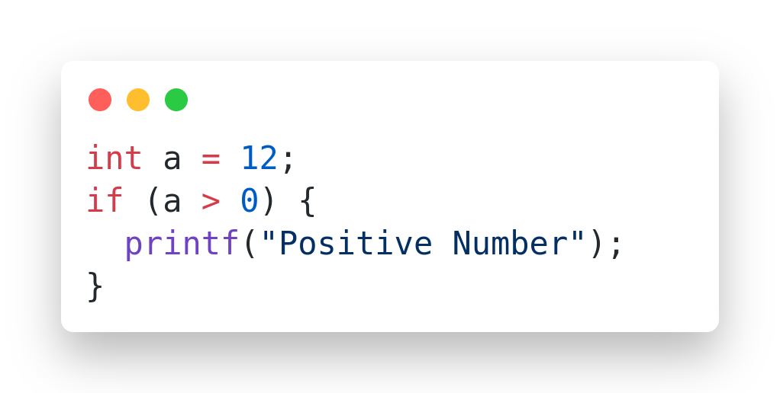
if Statement
if is single branch decision making statement.
If the condition is true then only body will be executed.
if is a keyword.
Syntax:
if (condition) {
// code
}

Slide 43
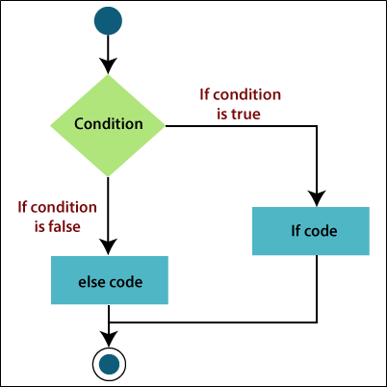
if…else Statement
if…else is two branch decision making statement
If condition is true then true part will be executed else false part will be executed
else statement to specify a block of code executed if the condition is false

Slide 44
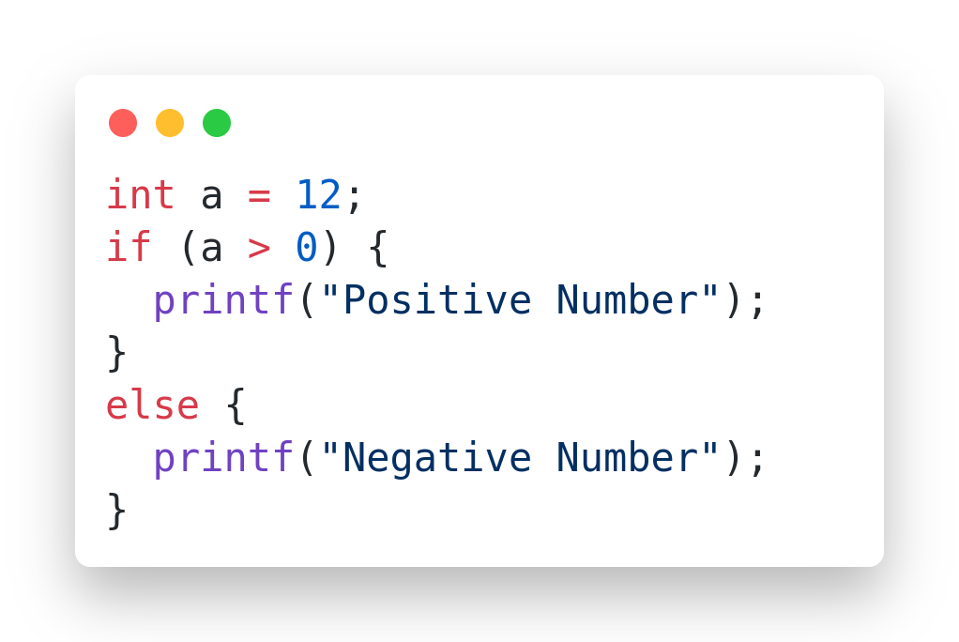
Syntax and Example
Syntax:
if (condition) {
// true part
} else {
// false part
}

Slide 45
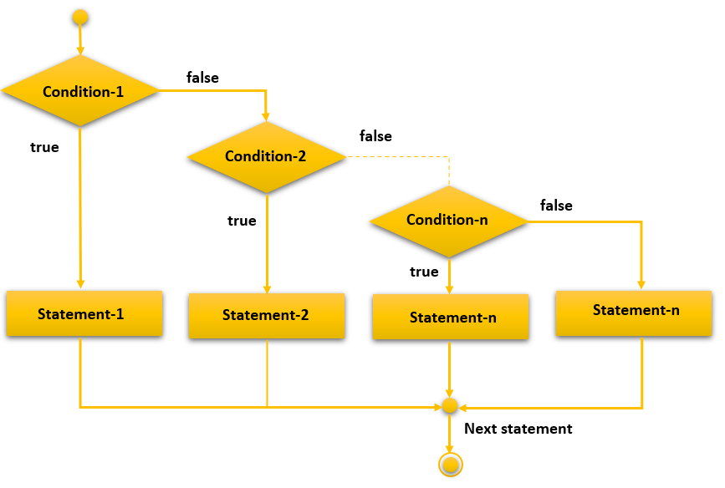
if…else if Ladder
if…else if ladder is multi branch decision making statement.
If first if condition is true then remaining else if conditions will not be evaluated.
If first if condition is false then second else if condition will be evaluated and if it is true then remaining else if conditions will not be evaluated.
if…else if ladder is also known as if…else if…else if…else

Slide 46
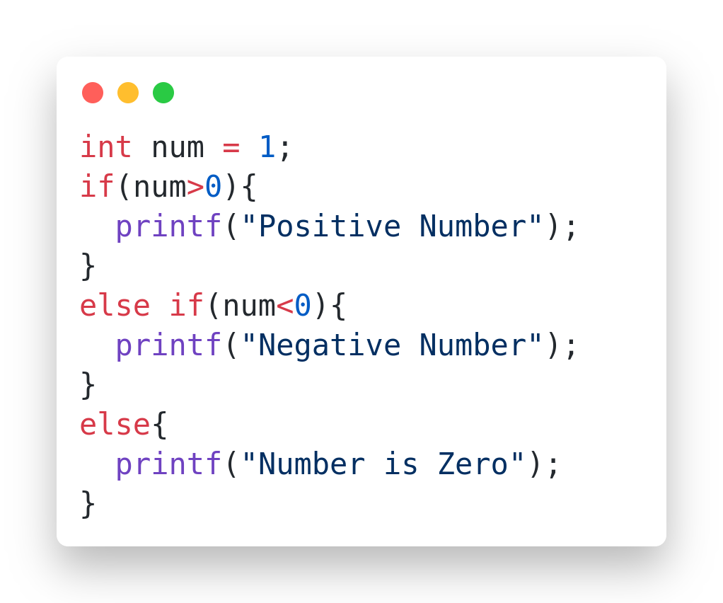
Syntax and Example
if(condition-1) {
// statement-1 } else if(condition-2) { // statement-2 }
else if(condition-n) { // statement-n } else { // else statement }

Slide 47
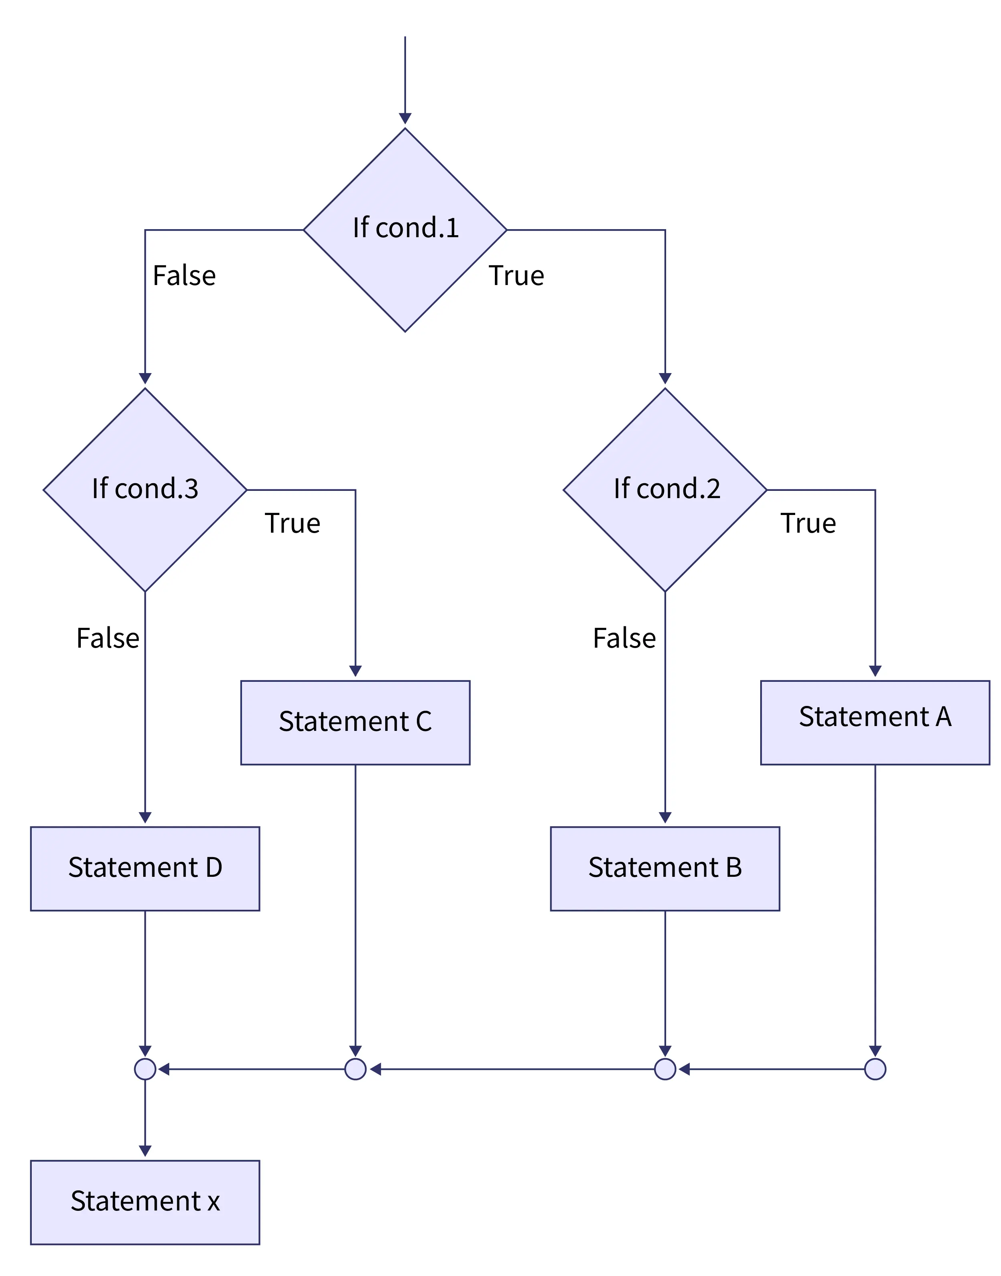
Nested if
If condition 1 is true, then condition-2 is evaluated.
If condition-2 is true, then Statement A will be executed.
If condition-2 is false, then Statement B will be executed.

Slide 48
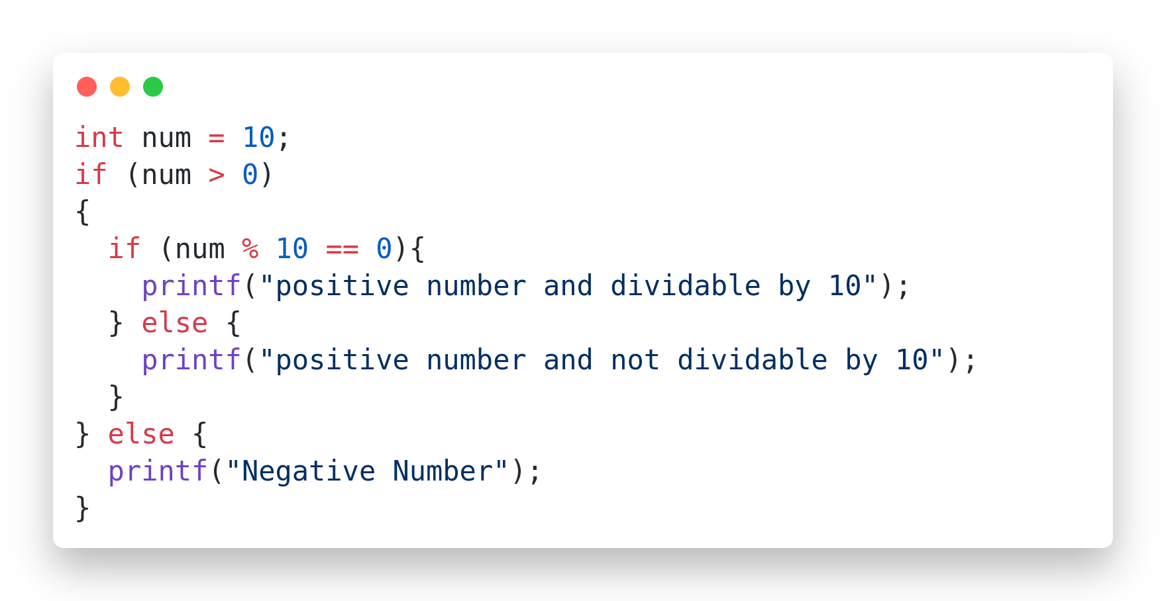
Syntax and Example
if( condition ){ if( condition ){ if( condition ){ ...... } } }

Slide 49
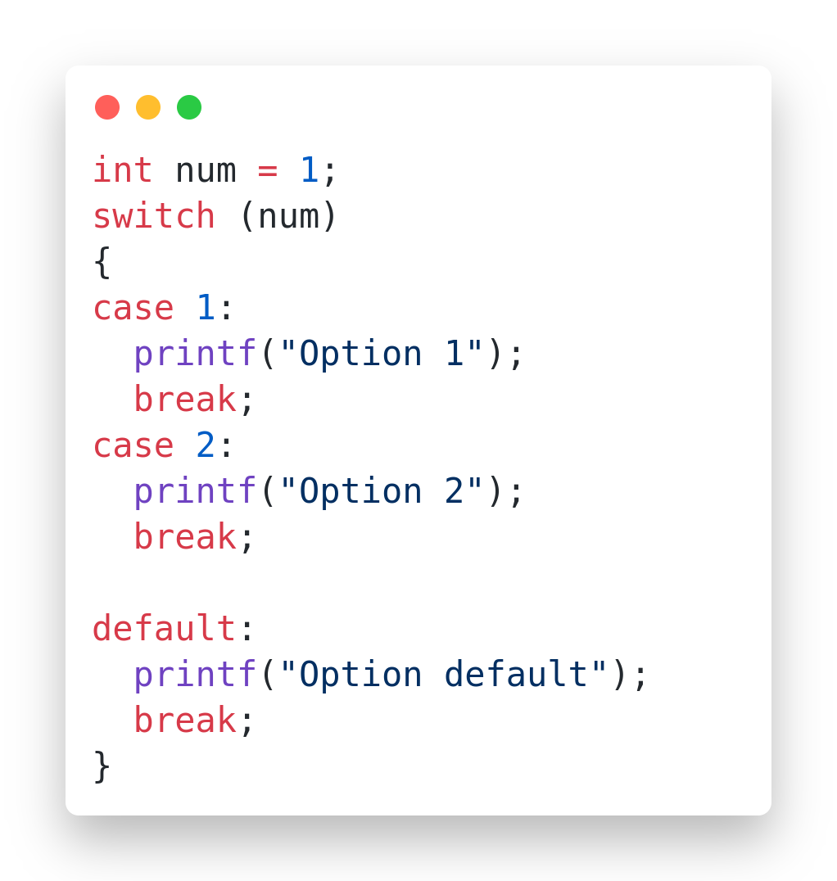
Switch Syntax and Example
switch(expression) { case value1: statement_1; break; case value2: statement_2; break; . . case value_n: statement_n; break; default: default_statement; }

Slide 50
Switch Case best Example
#include<stdio.h>
int main ( ) {
int days;
printf("Enter day(1-7) : ");
scanf("%d", &days);
switch (days)
{
case 1: printf("Monday\n");
break;
case 4: printf("Thursday\n");
break;
case 2: printf("Tuesday\n");
break;
case 3: printf("Wednesday\n");
break;
case 5: printf("Friday\n");
break;
case 6: printf("Saturday\n");
break;
case 7: printf("Sunday\n");
break;
default : printf("Enter a valid day..!!\n");
}
return 0;
}

Slide 51
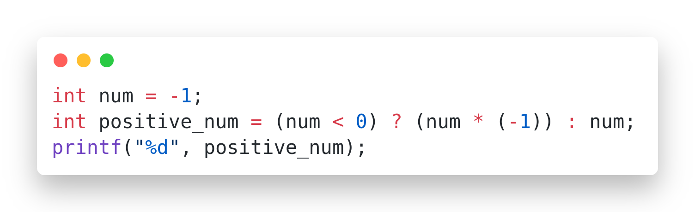
Conditional or Ternary Operator
There is a short-hand if else, which is known as the ternary operator because it consists of three operands. It can be used to replace multiple lines of code with a single line. It is often used to replace simple if else statements:
Syntax:
variable = (condition) ? Expression2 : Expression3;

Slide 52
Loops
Loops can execute a block of code as long as a specified condition is reached.
Loops are handy because they save time, reduce errors, and they make code more readable.
Type of Loops in C Language
1. while loop
2. do-while loop
3. for loop

Slide 53
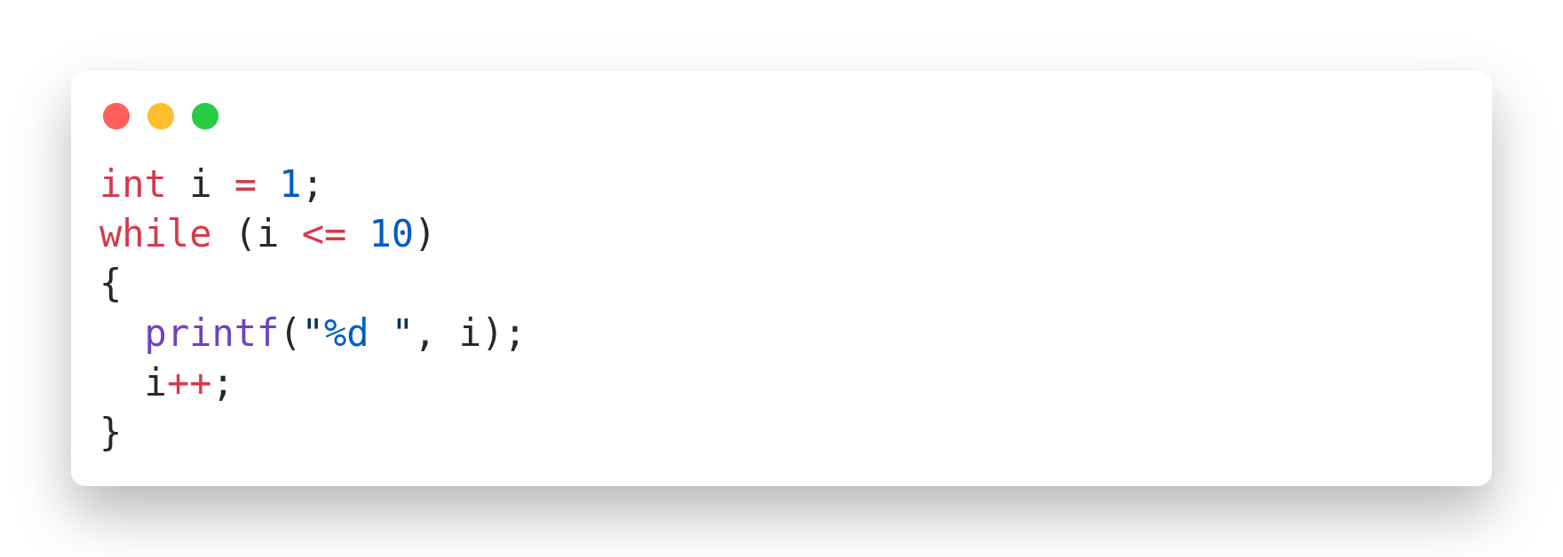
while Loop
The while loop loops through a block of code as long as a specified condition is true:
Syntax:
while (condition) { // code block to be executed }

Slide 54
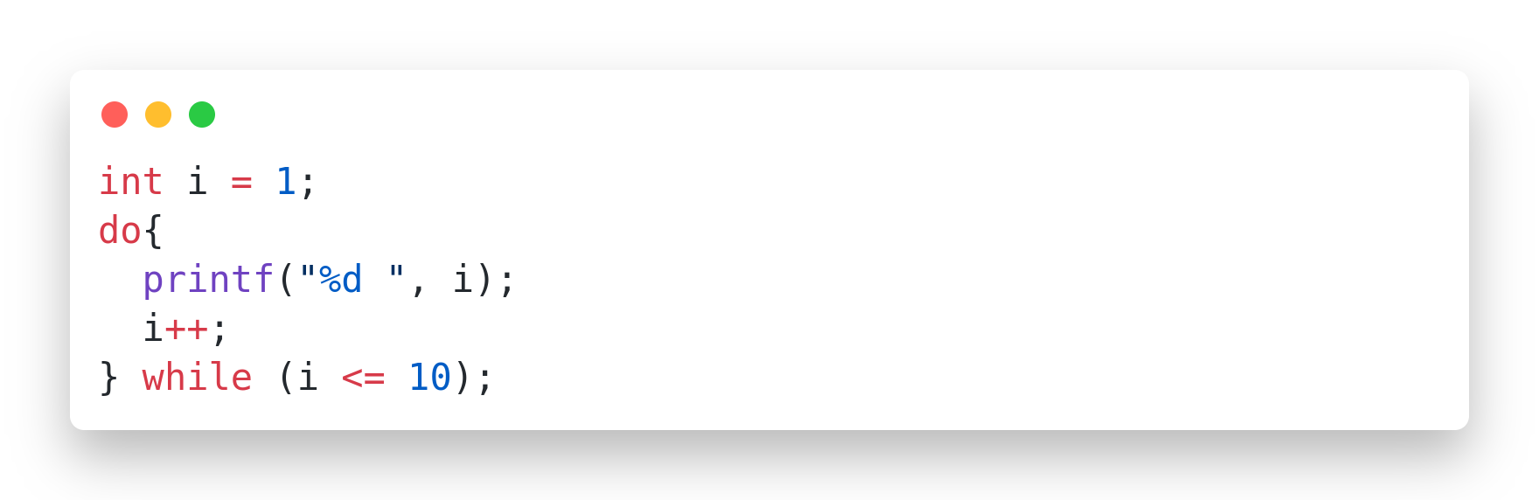
do-while Loop
The do/while loop is a variant of the while loop. This loop will execute the code block once, before checking if the condition is true, then it will repeat the loop as long as the condition is true.
Syntax:
do { // code block to be executed } while (condition);

Slide 55
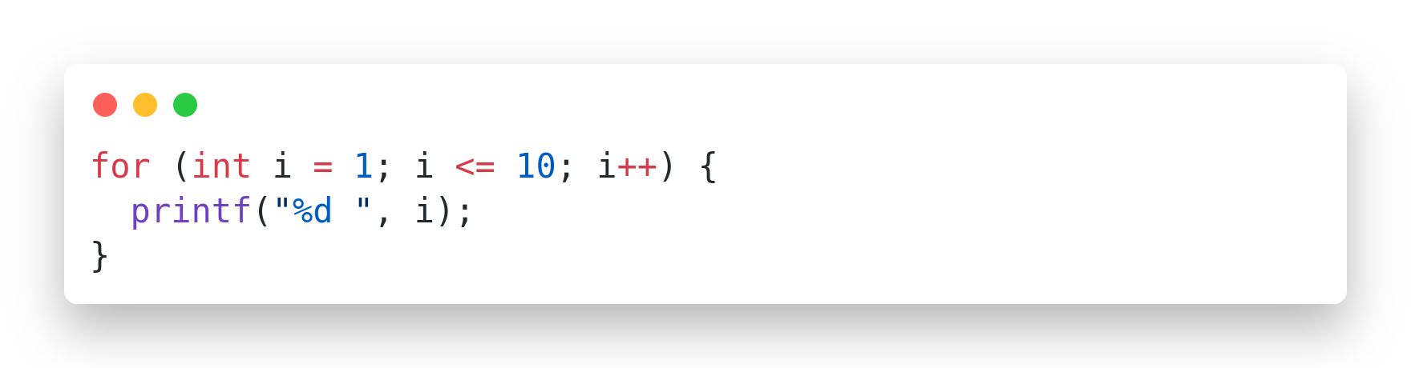
for Loop
When you know exactly how many times you want to loop through a block of code, use the for loop instead of a while loop:
Syntax:
for (expression 1(initialization); expression 2(condition); expression 3(increment/decrement)) { // code block to be executed }

Slide 56
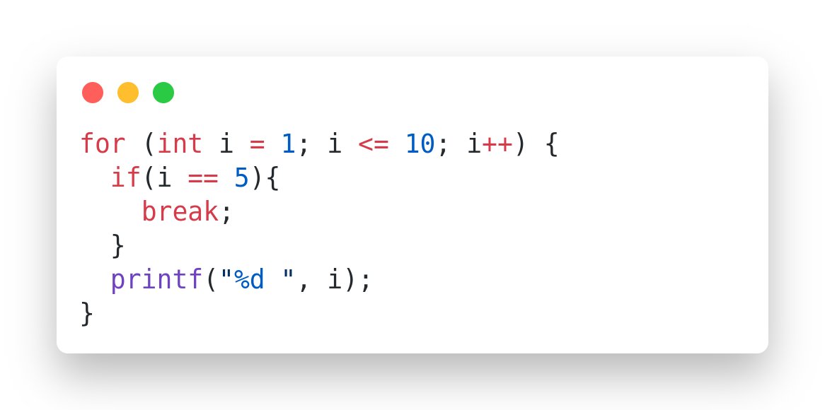
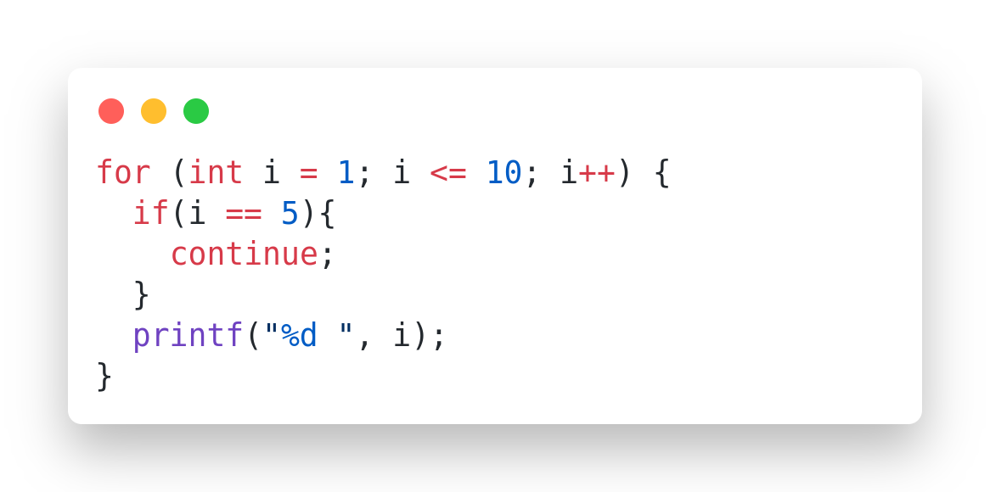
break and Continue
The break statement can be used to jump out of a loop.
The continue statement breaks one iteration (in the loop), if a specified condition occurs, and continues with the next iteration in the loop.

Slide 57
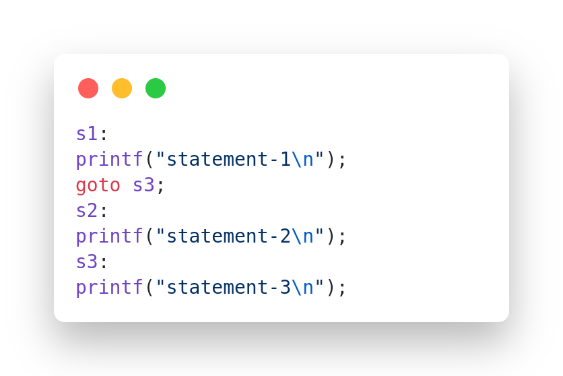
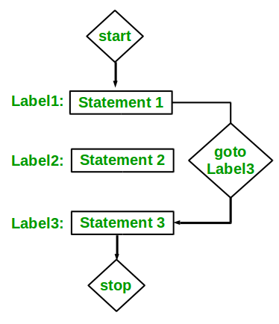
goto statement
The C goto statement is a jump statement which is sometimes also referred to as an unconditional jump statement. The goto statement can be used to jump from anywhere to anywhere within a function.

Slide 58
Arrays & Strings in
C

Slide 59
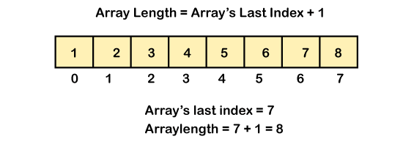
What is Array?
An array is a fixed size sequential collection of elements of same data type grouped
under single variable name.

Slide 60
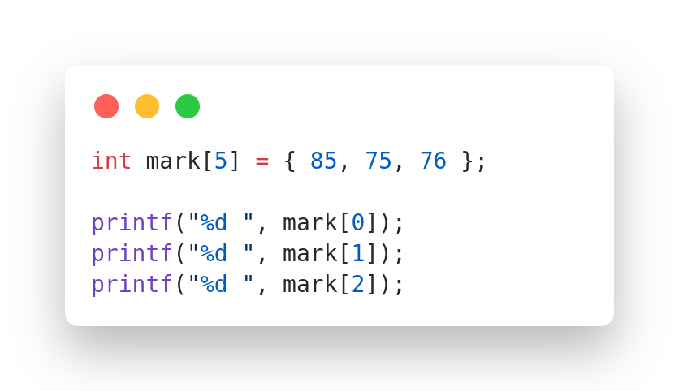
Array Syntax and Example
Syntax:
data-type variable-name[size];

Slide 61
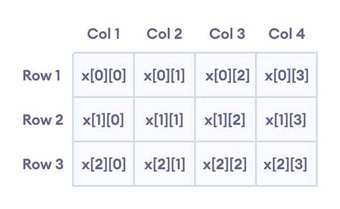
2-Dimensional Array
A two dimensional array can be seen as a table with ‘x’ rows and ‘y’ columns.
The row number ranges from 0 to (x-1) and column number ranges from 0 to (y-1).

Slide 62
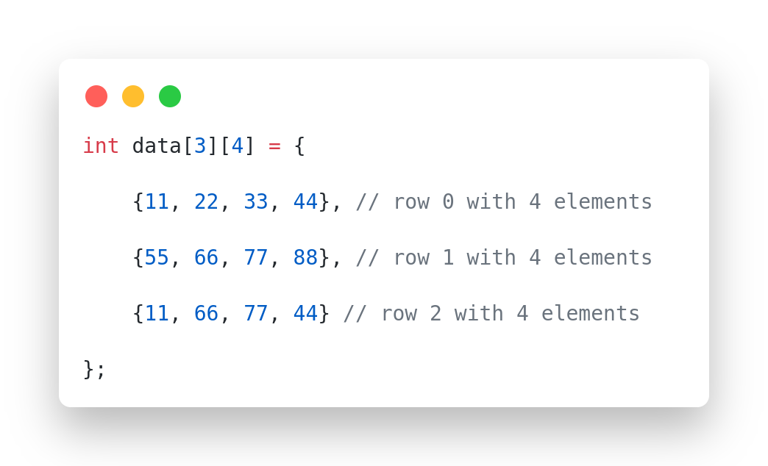
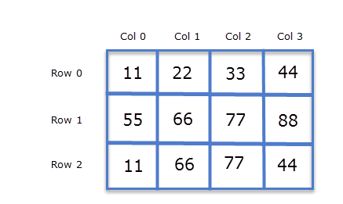
2-D Array Syntax and Example
Syntax:
data-type variable-name[x][y];

Slide 63
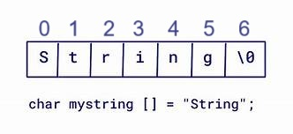
String in C
A string in C is a one-dimensional array of char type, with the last character in the array being a "null character" represented by '\0'.
A string in C can be defined as a null-terminated sequence of char type values.
Syntax:
char string_name[size];

Slide 64
C String Initialization
1. Assigning a String Literal without Size
char str[] = "HelloWorld";
2. Assigning a String Literal with a Predefined Size
char str[50] = "HelloWorld";
3. Assigning Character by Character with Size
char str[11] = {'H','e','l','l','o','W','o','r','l','d','\0'};
4. Assigning Character by Character without Size
char str[] = {'H','e','l','l','o','W','o','r','l','d','\0'};

Slide 65
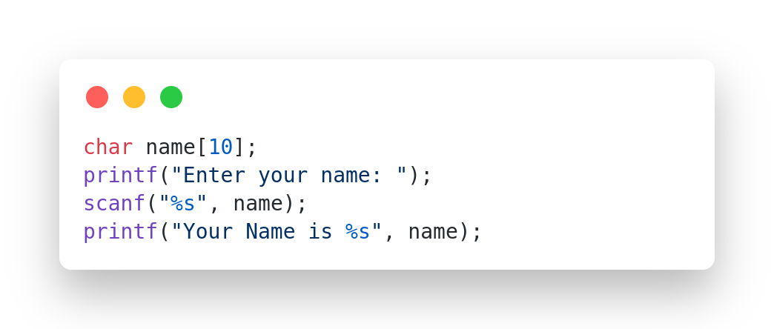
Read String Using scanf()

Slide 66
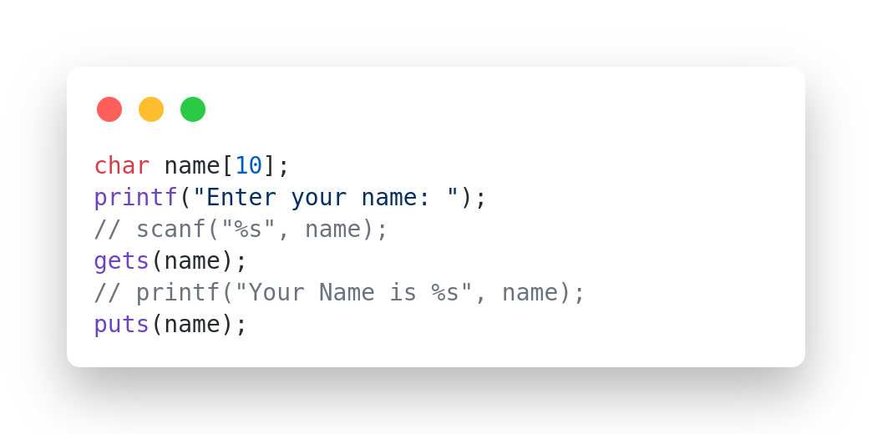
Read String Using gets()

Slide 67
String Handling Functions
C has several inbuilt functions to operate on string. These functions are known as
string handling functions.
We require to include string.h header file for using built-in string functions.

Slide 68
Name of Function | Syntax | Meaning | Example
strlen | strlen(s) | Finds the length of string s. | strlen("CPU") returns 3.
strcpy | strcpy(dest, src) | Copies the string src to dest. | If dest="Hello" and src="World" then strcpy(dest, src) : makes dest="World"
strcat | strcat(s1, s2) | Concatenate string s2 at the end of string s1. | If s1="Hello" and s2="World", strcat(s1, s2): makes s1 = "HelloWorld".
strcmp | strcmp(s1, s2) | Compares strings s1 and s2. If s1 == s2, returns 0; if s1 < s2, returns a negative value; if s1 > s2, returns a positive value. | strcmp("ABC", "ABD") returns a negative value, as "ABC" is less than "ABD".
strupr | strupr(s) | Converts string s to uppercase. | If s="Hello", strupr(s): makes s = "HELLO".
strlwr | strlwr(s) | Converts string s to lowercase. | If s="Hello", strlwr(s) : makes s = "hello".

Slide 69
Functions in
C

Slide 70
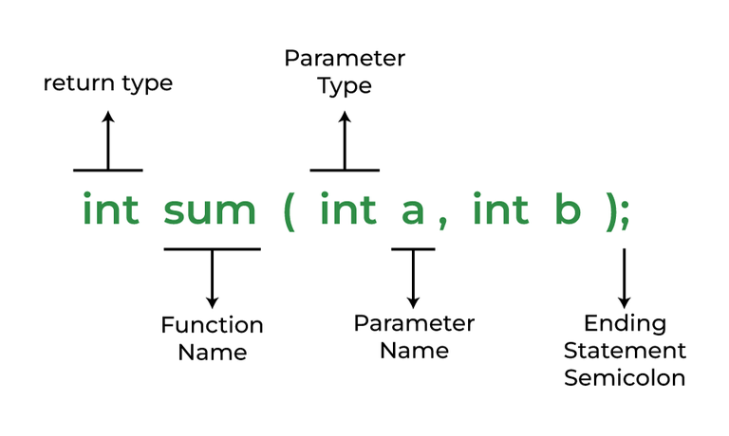
Functions
A function in C is a set of statements that when called perform some specific task. It is the basic building block of a C program that provides modularity and code reusability. The programming statements of a function are enclosed within { } braces, having certain meanings and performing certain operations. They are also called subroutines or procedures in other languages.
Syntax of Functions in C
The syntax of function can be divided into 3 aspects:
Function Declaration
Function Definition
Function Calls

Slide 71
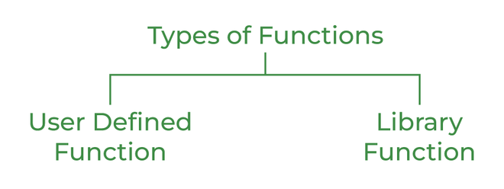
Types of Functions
Library Function
A library function is also referred to as a “built-in function”. A compiler package already exists that contains these functions, each of which has a specific meaning and is included in the package.
Example:-
pow(), sqrt(), strcmp(), strcpy() etc.
2. User Defined Function
Functions that the programmer creates are known as User-Defined functions or “tailor-made functions”. User-defined functions can be improved and modified according to the need of the programmer.

Slide 72
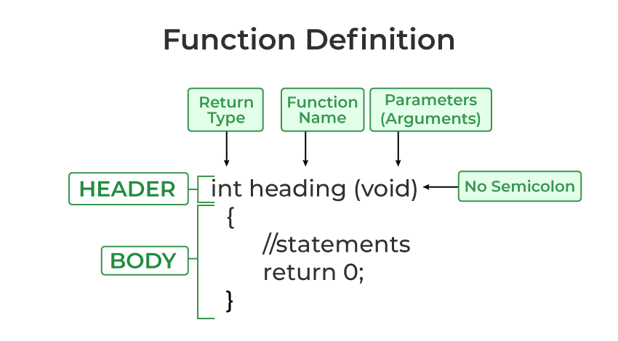
Function Declarations
return_type name_of_the_function (parameter_1, parameter_2);
Note: A function in C must always be declared globally before calling it.
int sum(int a, int b); // Function declaration with parameter names int sum(int , int); // Function declaration without parameter names
Function Definition
return_type function_name (para1_type para1_name, para2_type para2_name) { // body of the function }

Slide 73
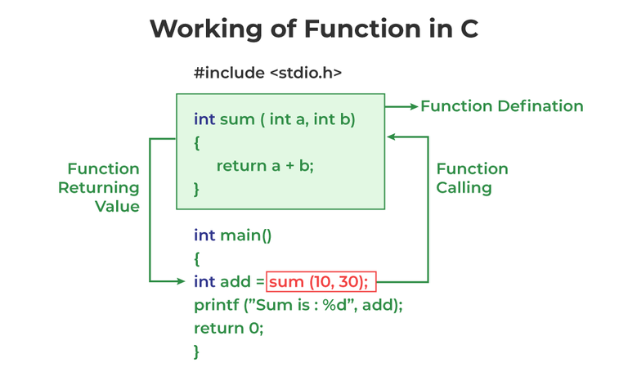
Function Call
// C program to show function
// call and definition
#include <stdio.h>
int sum(int a, int b)
{
return a + b;
}
int main() {
int add = sum(10, 30);
printf("Sum is: %d", add);
return 0;
}

Slide 74
Passing Parameters to Functions
We can pass arguments to the C function in two ways:
Pass by Value
Pass by Reference
Pass by Value
Parameter passing in this method copies values from actual parameters into formal function parameters. As a result, any changes made inside the functions do not reflect in the caller’s parameters.
Pass by Reference
The caller’s actual parameters and the function’s actual parameters refer to the same locations, so any changes made inside the function are reflected in the caller’s actual parameters.

Slide 75
Recursion in
C

Slide 76
Recursion in C
Recursion is the technique of making a function call itself.
This technique provides a way to break complicated problems down into simple problems which are easier to solve.
Terms in Recursion
Base Case : This is the condition that stops the recursion.
- When the base case is met, the function returns a value without making any further recursive calls.
2. Recursive Case : This is the part of the function that includes the recursive call.
Example: Tower of Hanoi, Fibonacci series, Factorial finding etc.

Slide 77
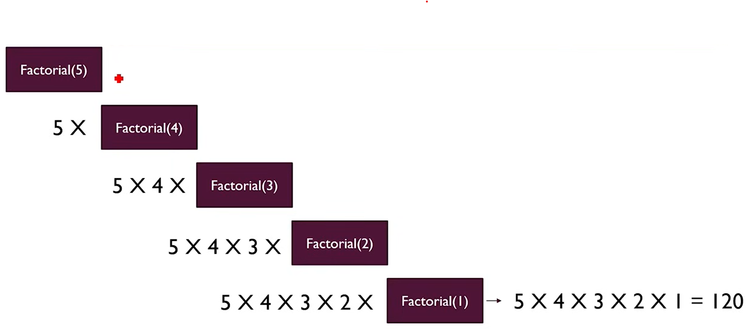
How Recursion Works
Breaks complex problems into simpler sub-problems
Repeats process until base case is met
Combines solutions of sub-problems

Slide 78
Example : Factorial Calculation
#include <stdio.h>
int factorial(int num)
{
if (num==0 || num==1)
{
return 1;
}
else{
return(num * factorial(num-1));
}
}
int main() {
int num;
printf("Enter the Number : ");
scanf("%d", &num);
printf("Factorial of %d = %d", num,factorial(num));
return 0;
}
Base Case : 0!=1 and 1!=1
when n=0 or n=1, then the function returns 1.
Recursive Case : The function returns 𝑛 * factorial (𝑛−1) ,making a recursive call with n−1.

Slide 79
Structure in
C

Slide 80
Structure
Structure is a collection of logically related data items of different datatypes grouped
together under single name.
Structure is a user defined datatype.
Structure Members can be normal variables, pointers, arrays or other structures.
Structure Member names within the particular structure must be distinct from one another.
Access Structure Member:
1. Dot/period operator (.)
2. Arrow operator (->)

Slide 81
Structure Syntax
// Define Structure :
struct structure_name {
member1_declaration;
member2_declaration;
. . .
memberN_declaration;
};
// Declare Structure :
struct structure_name structure_variable;
// Access Structure Member :
structure_variable.member_name;
pointer_to_structure->member_name;

Slide 82


Structure Example
Structure Example

Slide 83
Pointers in
C

Slide 84
What is Pointers?
A normal variable is used to store value.
A pointer is a variable that store address / reference of another variable.
Pointer is derived data type in C language.
A pointer contains the memory address of that variable as their value.
Pointers are also called address variables because they contain the addresses of other variables.

Slide 85



Declare and initialization of pointer
Syntax:
Example:
Output:

Slide 86
Declare and initialization of pointer
p is integer pointer variable
& is address of or referencing operator which returns memory address of variable.
* is indirection or dereferencing operator which returns value stored at that memory address.
& operator is the inverse of * operator
x = a is same as x = *(&a)

Slide 87

Formal Parameters Vs Actual Parameters

Slide 88


Pass by Value
Pass by Reference

Slide 89

Swap Two numbers

Slide 90

Without using third variable

Slide 91
Relation between Array & Pointer
When we declare an array, compiler allocates continuous blocks of memory so that all the elements of an array can be stored in that memory.
The address of first allocated byte or the address of first element is assigned to an array name.
Thus array name works as pointer variable.
The address of first element is also known as base address.

Slide 92
Relation between Array & Pointer
Example: int a[10], *p;
a[0] is same as *(a+0),
a[2] is same as *(a+2),
a[i] is same as *(a+i) and so on ...

Slide 93

Program to find sum of all elements in array

Slide 94
Dynamic Memory Allocation (DMA) in
C

Slide 95
What is DMA?
If memory is allocated at runtime (during execution of program) then it is called dynamic memory.
Memory can be accessed only through a pointer
It allocates memory from heap (simply heap: it is an empty area in memory)
When DMA is needed?
It is used when number of variables are not known in advance or large in size.
Memory can be allocated at any time and can be released at any time during runtime

Slide 96
Malloc (Memory Allocation)
malloc() is used to allocate a fixed amount of memory during the execution of a program.
malloc() allocates size_in_bytes of memory from heap, if the allocation succeeds, a pointer to the block of memory is returned else NULL is returned.
The memory is not initialized. Thus we need explicit type conversion.
Syntax:
Example:

Slide 97
Calloc (contiguous allocation)
calloc() is used to allocate a block of memory during the execution of a program
calloc() allocates a region of memory to hold no_of_blocks of size_of_block each, if the allocation succeeds then a pointer to the block of memory is returned else NULL is returned.
The memory is initialized to ZERO.
Syntax:
Example:

Slide 98
realloc (re-allocation)
realloc() changes the size of the object pointed to by pointer fp to specified size.
The contents will be unchanged up to the minimum of the old and new sizes.
If the new size is larger, the new space will be uninitialized.
realloc() returns a pointer to the new space, or NULL if the request cannot be satisfied, in which case *fp is unchanged
Syntax:
Example:

